Slide 1
AI-GIS BASED MOBILE APPLICATION FOR
TRACKING DEEP SEA FISHERMEN
A.V.C. COLLEGE OF ENGINEERING
DEPARTMENT OF ELECTRONICS AND COMMUNICATION ENGINEERING
Presented by
S. Sivapriya (820320106022)
G. Udhaya (820320106026)
S. Vishwaja (820320106029)
GUIDE NAME: Dr. C. Jayasri, M. Tech., Ph. D (Assistant Professor)

Slide 2
Abstract
A technology for real-time tracking in low-connectivity deep-sea environments is crucial for enhancing the safety of fishermen. This project aims to address this challenge by creating an AI-based Geographic Information System (GIS) app.
Leveraging advanced algorithms, the app will accurately detect and track deep-sea fishermen's locations during maritime activities.
With a user-friendly interface, the app will provide comprehensive monitoring, ensuring safety in remote and challenging environments.
The anticipated outcome is an innovative GIS app that significantly improves tracking capabilities, contributing to enhanced safety measures and efficient maritime activities, thus positively impacting the well-being of deep-sea fishermen.

Slide 3
Introduction
Deep-sea fishing is a vital industry contributing to global food supply and economic prosperity, yet it poses significant challenges due to the remote and unpredictable nature of the marine environment. One of the foremost concerns in deep-sea fishing is ensuring the safety and well-being of fishermen who navigate these treacherous waters.
Despite advances in maritime technology, the lack of reliable and continuous communication infrastructure in deep-sea locations presents a formidable barrier to establishing effective real-time tracking systems for fishermen.
Recognizing the critical need to address this safety gap, our project endeavors to develop an innovative AI-based Geographic Information System (GIS) application tailored specifically for detecting fishermen's locations during deep-sea fishing activities.

Slide 4
Objectives
To enhance safety measures for fishermen by providing timely and reliable location information, thereby mitigating risks associated with maritime activities in challenging oceanic conditions.
To detect and track the locations of fishermen engaged in deep-sea fishing activities.
To accurately pinpoint the real-time whereabouts of fishermen operating in remote and low-connectivity deep-sea environments by leveraging advanced artificial intelligence algorithm.
To improve emergency response capabilities by developing features that quickly relay distress signals and real time location data to relevant authorities for prompt search and rescue operation.
To ensure that the technology is accessible to a wide range of users, including fishermen with varying levels of technological expertise

Slide 5
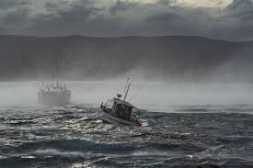
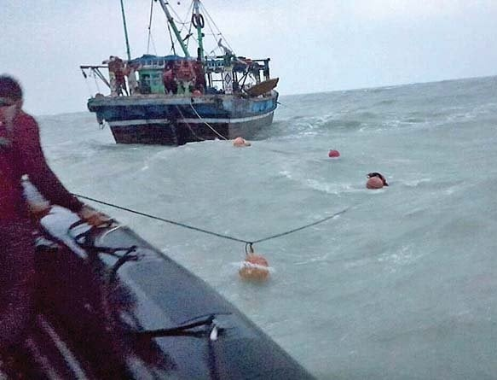
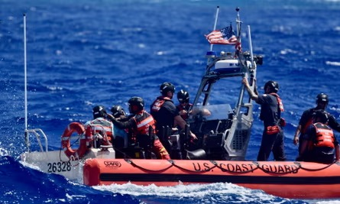
Project Goal
The goal of project the is to enhance safety measures for fishermen by providing timely and reliable location information, thereby mitigating risks associated with maritime activities in challenging oceanic conditions.

Slide 6
Literature Survey
SI. No | Title & Year | Author | Description | Merits | Demerits
1 | LiFi: A Visible Light Communication Assisted Fishermen Tracking System using GPS.2023 | K. Prabhu Chandran | The term "Li-Fi" refers to a type of wireless optical communication that uses visible light and is both fast and completely networked. | Precision Real-time tracking | Limited coverage area Interference from obstacles
2 | A Web-GIS and Mobile Based Application for a Safe Ocean for Fishers. 2021 | Sujith Kumar Saka | This application will provide the compass, weather, rescue plan, offline maps and potential fishing zone through GIS. | Enhanced tracking accuracy Real-time monitoring capabilities | High initial setup costs Potential signal interference
3 | Hardware Implementation of Fishermen Radio for Data Communication via Audio Signal on Very High Frequency (VHF) Spectrum.2023 | Dian Shafira Khoirunnisa | An audio signal with a frequency of 156.5 MHz is transmitted using the DRA818V transceiver module. | Utilization of existing infrastructure Wide coverage area | Limited data transmission capacity Vulnerability to signal interference

Slide 7


SI.No | Title & Year | Author | Description | Merits | Demerits
4 | Radio Frequency Communication Based Safety and Security System for Fishermen.2019 | Ajaykumar Maurya | The master has information about the location of each boat in real-time | Wide coverage range Established infrastructure | Limited data transmission capacity Susceptibility to signal interference
5 | Research on the Key Technology of Fishermen Safety Guarantee System.2023 | Chengyu Yang | The system involves three terminals: fishing vessel terminal, shore-based terminal, and fishermen terminal | Potential for industry advancement ustomized safety measures | High research and development costs Time-consuming implementation process

Slide 8
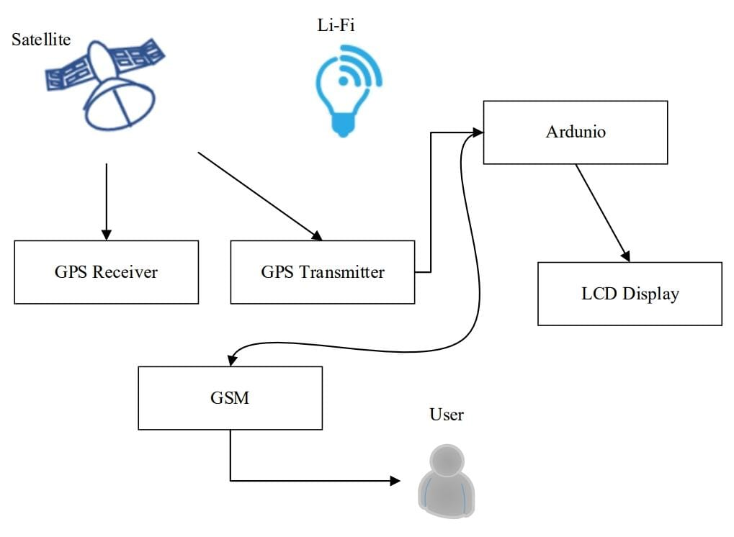

Existing System
LiFi-based fishermen tracking system using GPS incorporates visible light communication (VLC) technology to enhance the accuracy and reliability of tracking fishermen in maritime environments.
Additionally, LiFi technology provides inherent advantages such as increased security, immunity to electromagnetic interference, and reduced latency, making it an ideal solution for enhancing the efficiency and safety of maritime operations.

Slide 9
Drawbacks of Existing System:
Limited Coverage Area
Weather Dependence
Interference from Obstructions
High Implementation Cost
Compatibility with Existing Infrastructure

Slide 10
Proposed System
An AI-based Geographic Information System (GIS) application specifically tailored for detecting and tracking the locations of fishermen engaged in deep-sea fishing activities. Leveraging advanced artificial intelligence and machine learning algorithms, the app will analyze relevant data such as GPS coordinates, environmental conditions, and vessel movements to provide real-time location information.
This innovative solution will offer a comprehensive and user-friendly interface for effective monitoring, ensuring the safety of fishermen operating in remote and challenging deep-sea environments. By improving tracking capabilities and enhancing safety measures, the proposed system aims to contribute to the efficiency and well-being of deep-sea fishermen while addressing critical aspects of maritime safety.

Slide 11
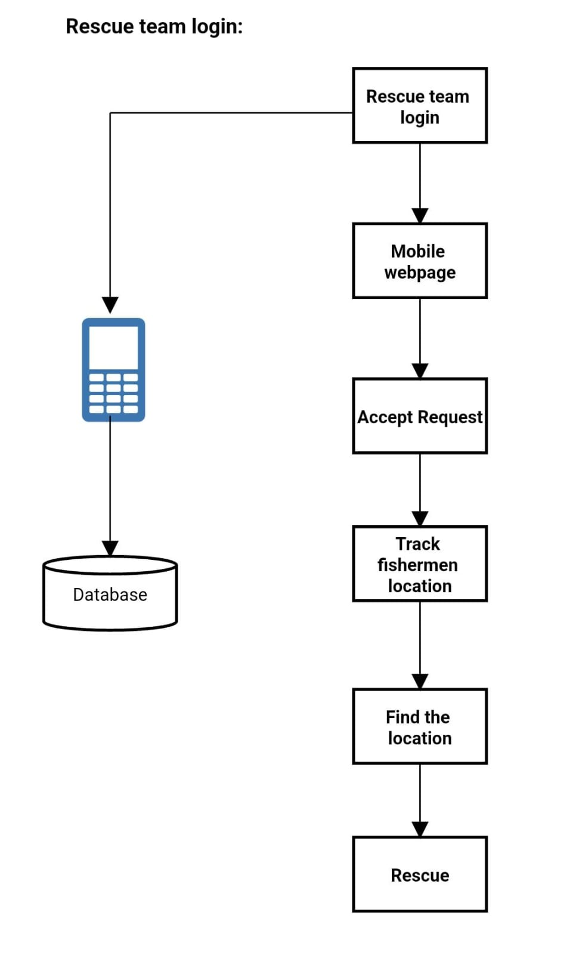
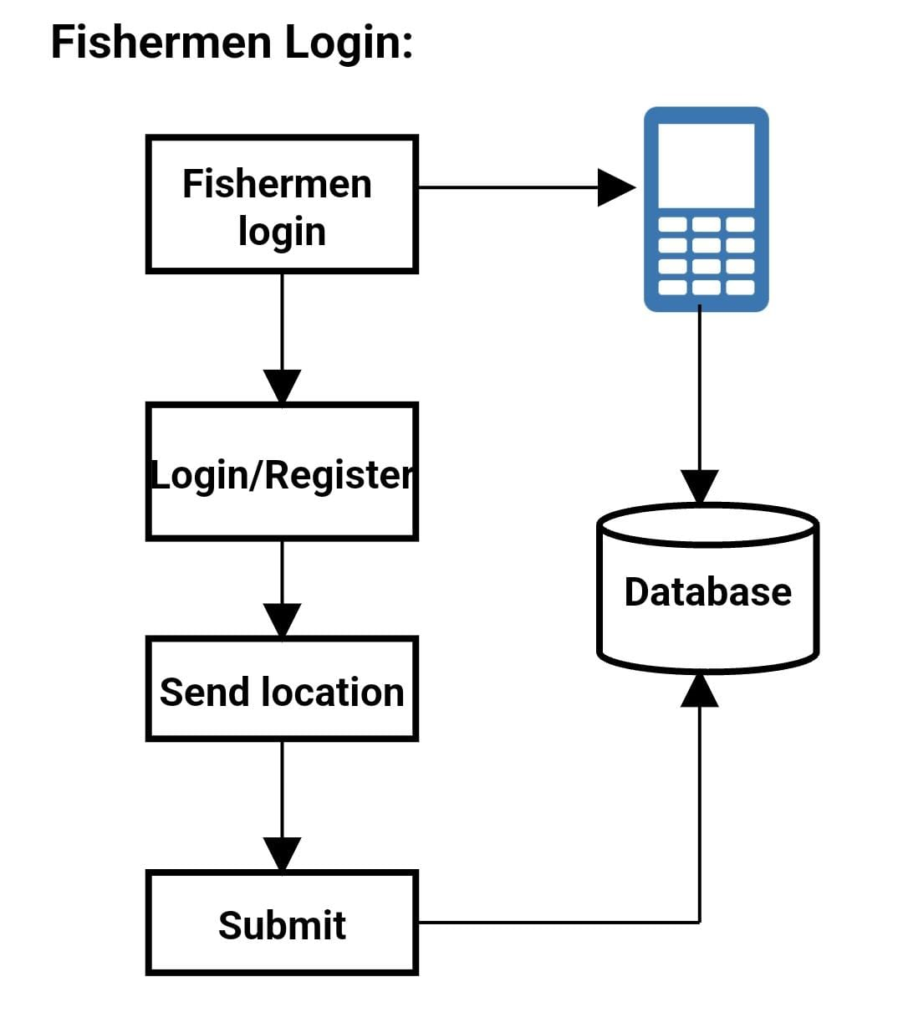
Proposed System

Slide 12
Advantages of Proposed System:
Enhanced safety through monitoring.
Accurate real-time location tracking.
User-friendly interface for monitoring.
Effective utilization of AI.
Improved efficiency and well-being.

Slide 13
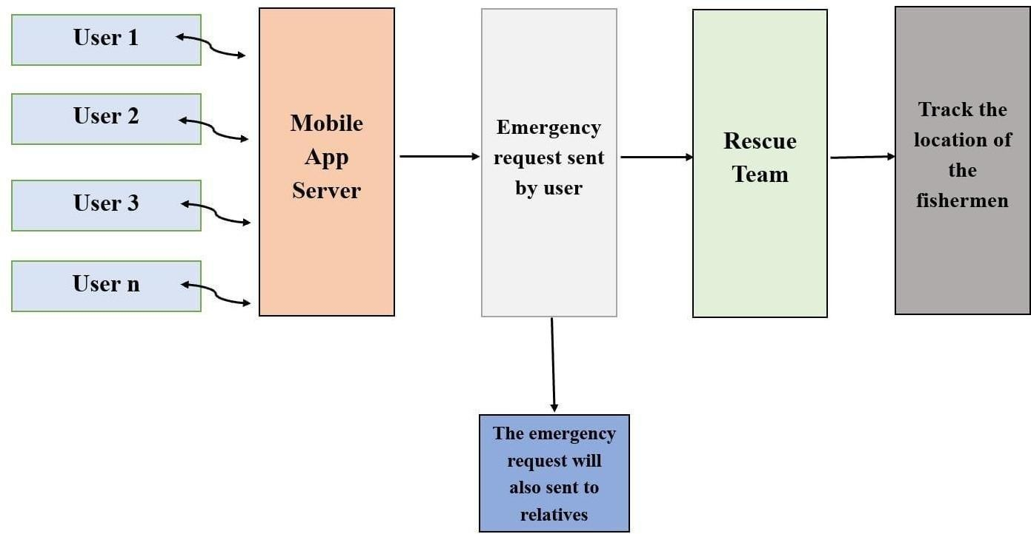
Block Diagram

Slide 14
Methodology
The development of an AI-GIS based mobile application for tracking deep-sea fishermen involves data collection includes GPS, oceanographic, and weather data, which is integrated into a GIS platform for spatial visualization.
Preprocessing ensures data cleanliness and standardization.
AI models are developed to extract insights like predicting fishing hotspots and detecting anomalies, based on historical data.
Real-time tracking is enabled through mobile integration.
Continuous user feedback refines the application.
Compliance with regulations and privacy laws, especially regarding sensitive data, is essential.
Deployment, maintenance, and updates ensure continued functionality.
This approach creates a powerful tool for enhancing the efficiency and sustainability of deep-sea fishing practices, benefiting fishermen and regulatory agencies.

Slide 15
Experimental Results
AI based GIS application's ability to accurately detect and track fishermen engaged in deep-sea fishing activities in real-time.
By analyzing GPS coordinates, environmental conditions, and vessel movements, the app provides valuable location information, enhancing safety measures and monitoring capabilities for fishermen operating in remote and challenging deep-sea environments.

Slide 16
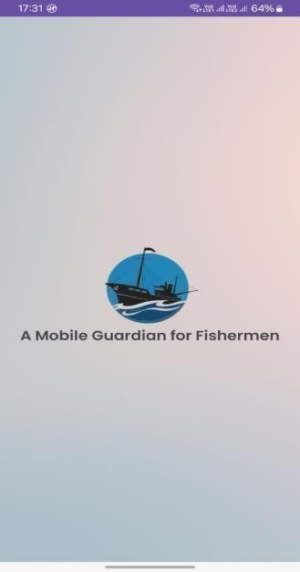
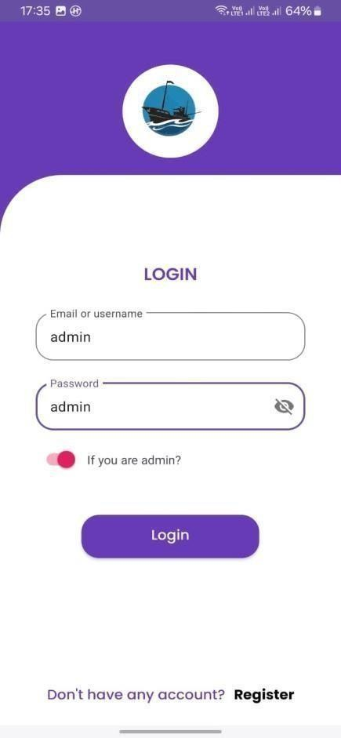
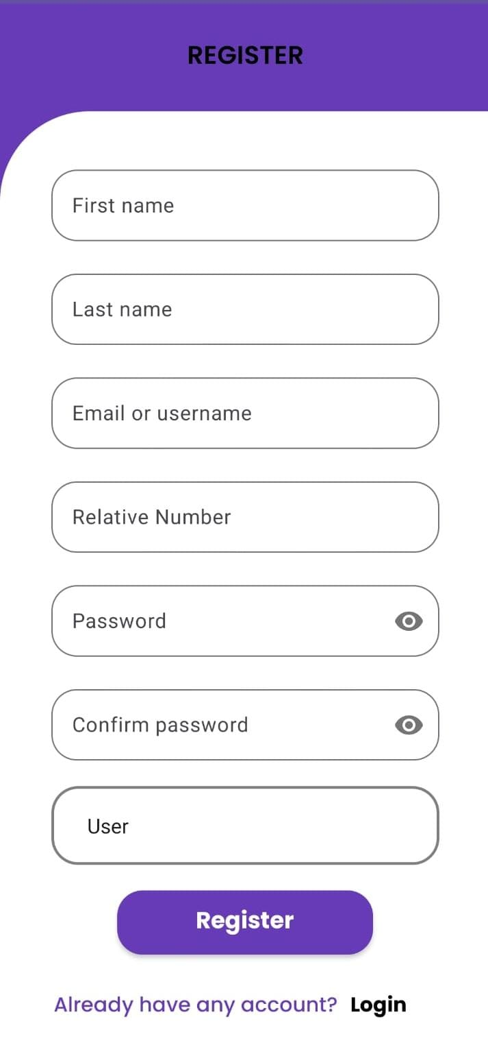
App preview page:
Admin Login page:
User Register page:

Slide 17
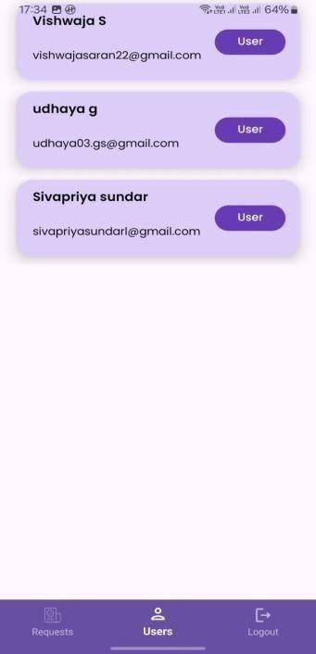
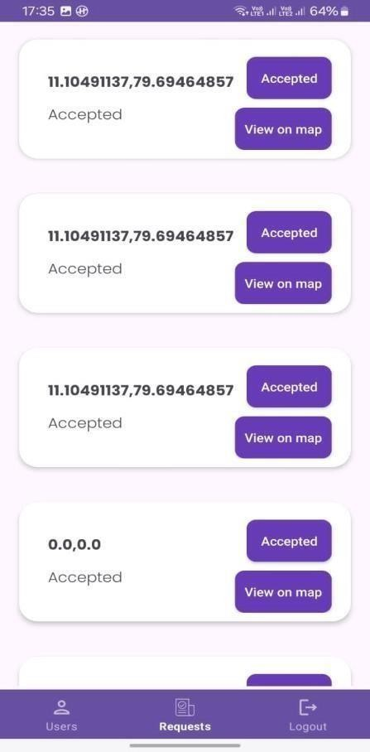
List of Users:
Requests by the user:

Slide 18

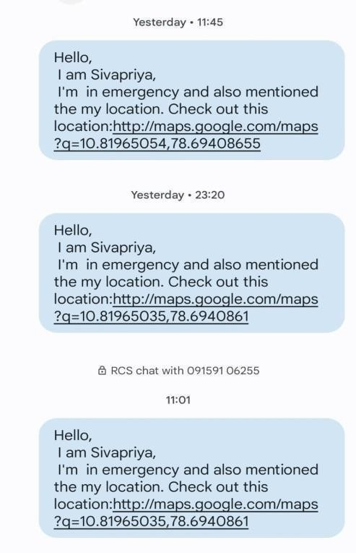
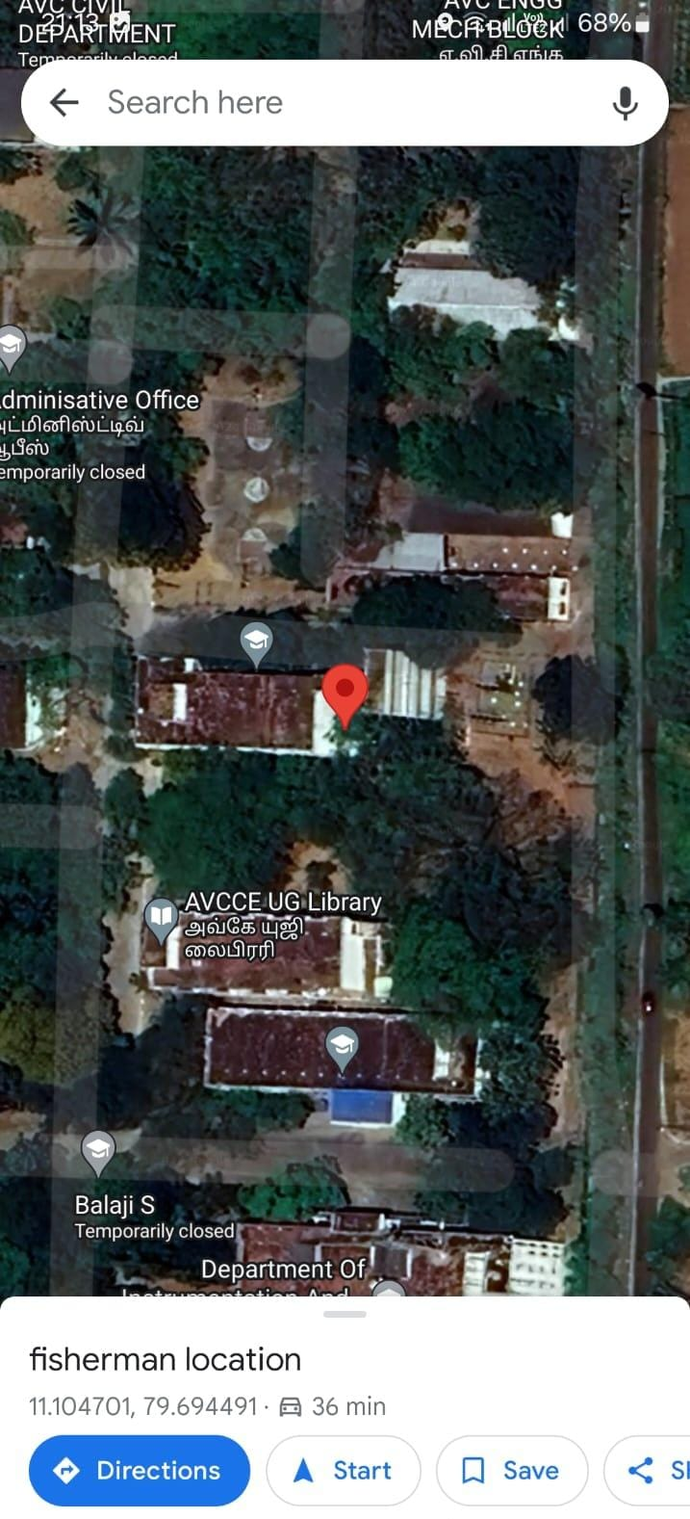
Emergency request from the fishermen:
Emergency message via SMS:
Location display on map:

Slide 19
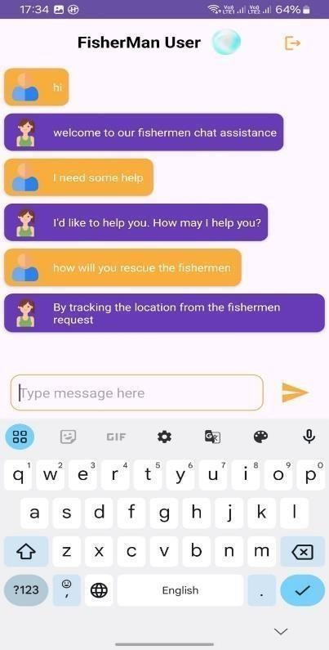
AI chatbot :

Slide 20
System Requirements
HARDWARE REQUIREMENTS
Processors: Intel® Core™ i5 processor 4300M at 2.60 GHz or 2.59 GHz (1 socket, 2 cores, 2 threads per core), 8 GB of DRAM
Disk space: 320 GB
Operating systems: Windows® 10, macOS*, and Linux*
SOFTWARE REQUIREMENTS
Server Side : Android studio
Client Side : HTML, CSS, Bootstrap
IDE : Flask 1.1.1
Back end : MySQL 5.
Server : WampServer 2i
OS : Windows 10 64 –bit

Slide 21

FUTURE SCOPE OF OUR PROJECT
This integrating satellite communication technology could enhance the app's resilience to adverse weather conditions and other environmental factors that may disrupt traditional communication methods. By embracing satellite communication technology, the GIS app could further strengthen its ability to enhance the safety and efficiency of deep-sea fishing operations, ultimately contributing to the well-being of fishermen and the sustainability of maritime activities.
The future scope of our project would be in case of unavailability of the rescue team the advanced technology AI will assist them in a right direction for the fishermen safety. By integrating AI assistance into deep-sea fishing operations, fishermen can gain valuable insights, improve their decision-making processes, and navigate the challenges of the marine environment more effectively while promoting sustainable fishing practices.

Slide 22
Conclusion
The development of an AI-based GIS app for detecting and tracking fishermen's locations in deep-sea fishing environments represents a significant step forward in enhancing maritime safety and efficiency. By leveraging advanced artificial intelligence and machine learning algorithms, this innovative solution offers real-time location information and effective monitoring capabilities, ensuring the safety of fishermen operating in remote and challenging deep-sea environments.
The comprehensive and user-friendly interface of the GIS app facilitates seamless integration into fishermen's workflow, contributing to improved safety measures and efficient maritime activities.

Slide 23
References
Kesavan TK and Lakshmi K, “GSM-Based Smart Marine Tracking System for Location Monitoring and Emergency Protection”, 2022.
Prabhu Chandran K, “Lifi: A Visible Light Communication Assisted Fishermen Tracking System using GPS”, 2023.
Tharwin Kumar R, “Fisherman Border System Based on IOT Fisherman Border Alert System Based on IOT”, vol. 1, pp. 37-44, 2022.
Thomas T and Mary M, "A WSN-based maritime border alert system to protect fishermen",. vol. 1, 2021.
Vivek Ganesh and Karthikaa Raja, “ A Web-GIS and Mobile-Based Application for a Safe Ocean for Fishers”, vol. 55, pp.50-55, 2021.

